Slide 1
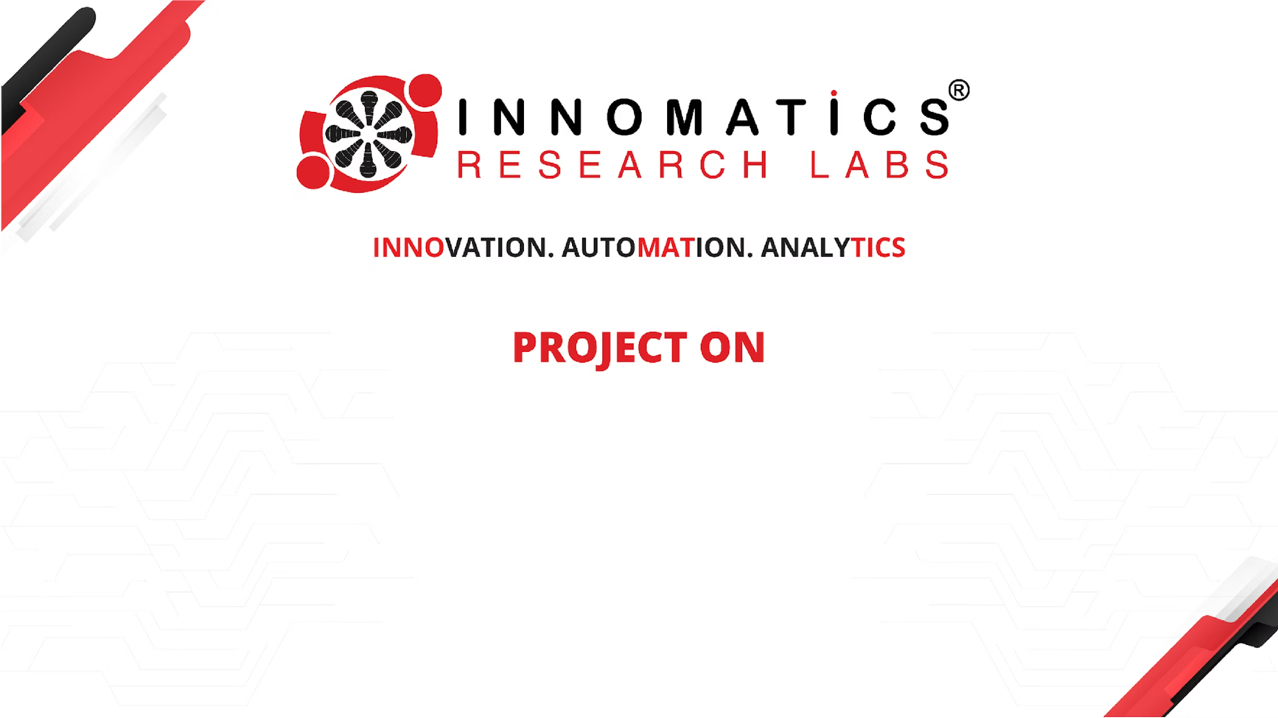
Job Market Insights and Skill Demand Analysis
Presented By: A. Gopichand
A deep dive into current trends and future predictions in the AI and Data Science job landscape.

Slide 2



Meet the Analyst: A. Gopichand
I am Anabathula Gopichand, a recent graduate holding a Bachelor of Technology in Computer Science, specializing in Artificial Intelligence & Data Science from CMR College of Engineering & Technology.
My passion for Data Science stems from its unique blend of attributes that resonate deeply with me:
Analytical Thinking
The challenge of deconstructing complex problems.
Technological Innovation
Leveraging cutting-edge tools and methodologies.
Strategic Impact
Transforming data into actionable insights for meaningful change.

Slide 3

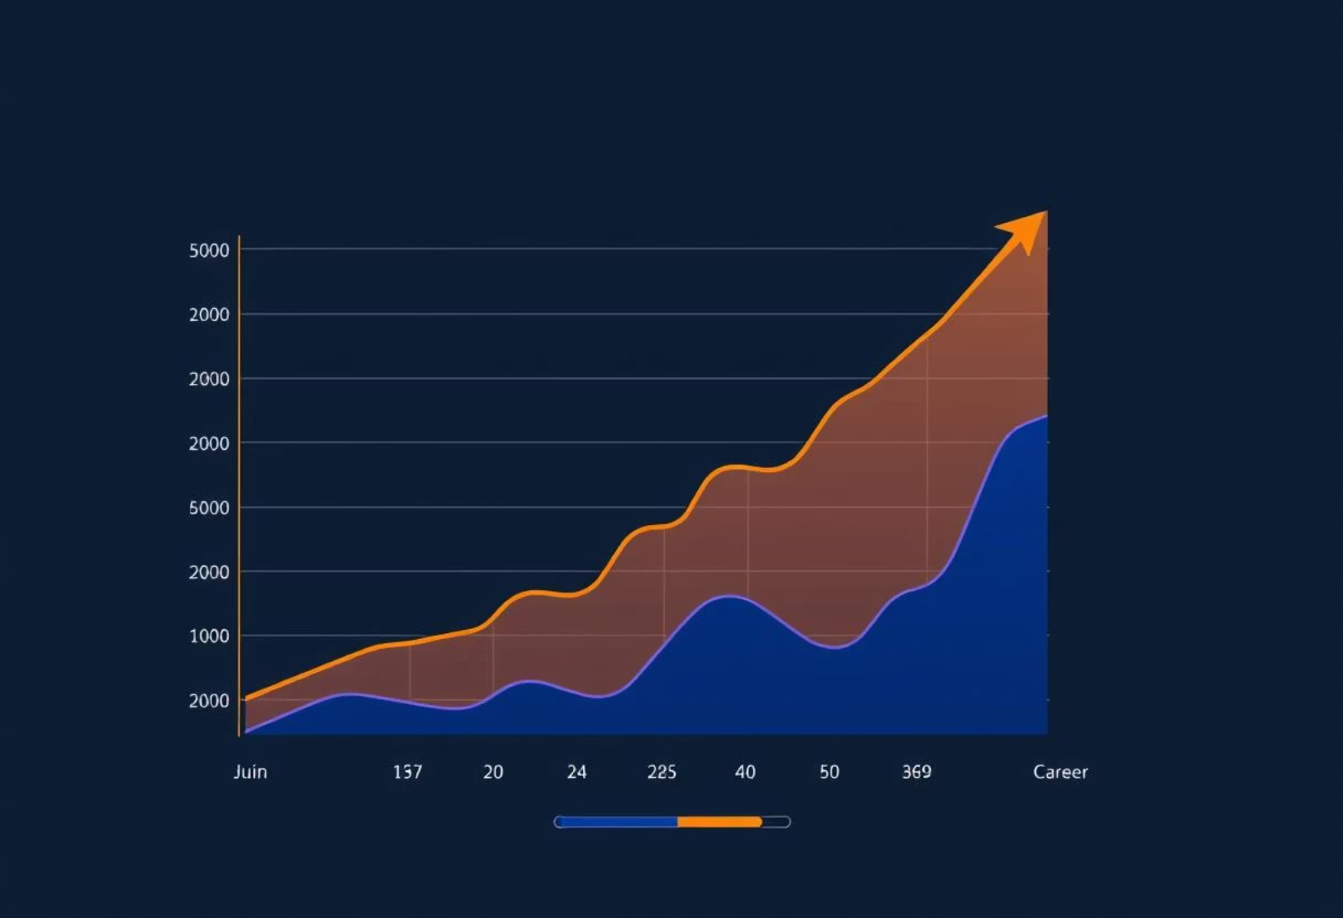
AI Job Trends: Dataset Overview
This project rigorously analyzes a comprehensive dataset of job listings to illuminate the current dynamics of the Artificial Intelligence and Data Science job market. Our primary objective is to extract meaningful insights into key areas shaping career opportunities.
1
2
Dataset Scope
Analytical Focus
Comprises 79,147 job listings, providing a robust foundation for market trend analysis.
Explores trends in job roles, required experience, salary expectations, and in-demand skills.
The dataset is rich, including 12 columns featuring both categorical data (e.g., job_role, company) and numerical data (e.g., rating), all contributing to a holistic understanding of market demand.

Slide 4
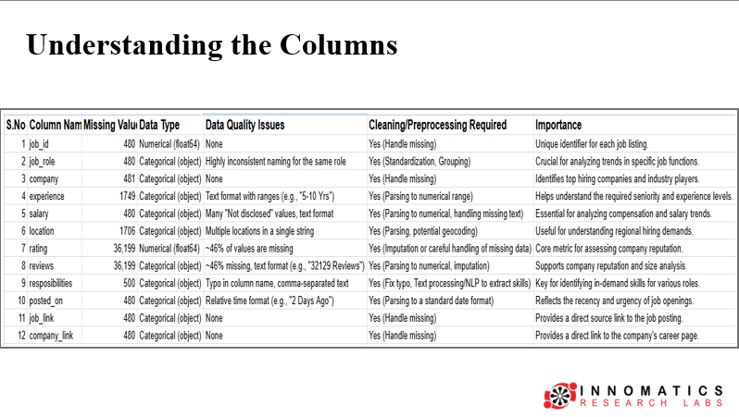

Slide 5

Key Questions Driving Our Analysis
Our investigation is framed by a series of critical questions, designed to uncover actionable insights into the AI and Data Science job market:
What is the total number of jobs and unique companies represented in the dataset?
Who are the Top 5 companies with the most job openings?
Which companies are actively recruiting for Data Analyst roles?
What are the most common skills required across almost all job categories?
What skills are essential to secure a position at major organizations like HDFC Bank?
What foundational skills are indispensable for aspiring Data Analysts?
How does the volume of job opportunities correlate with required years of experience?
What are the average salary expectations for various experience levels?

Slide 6
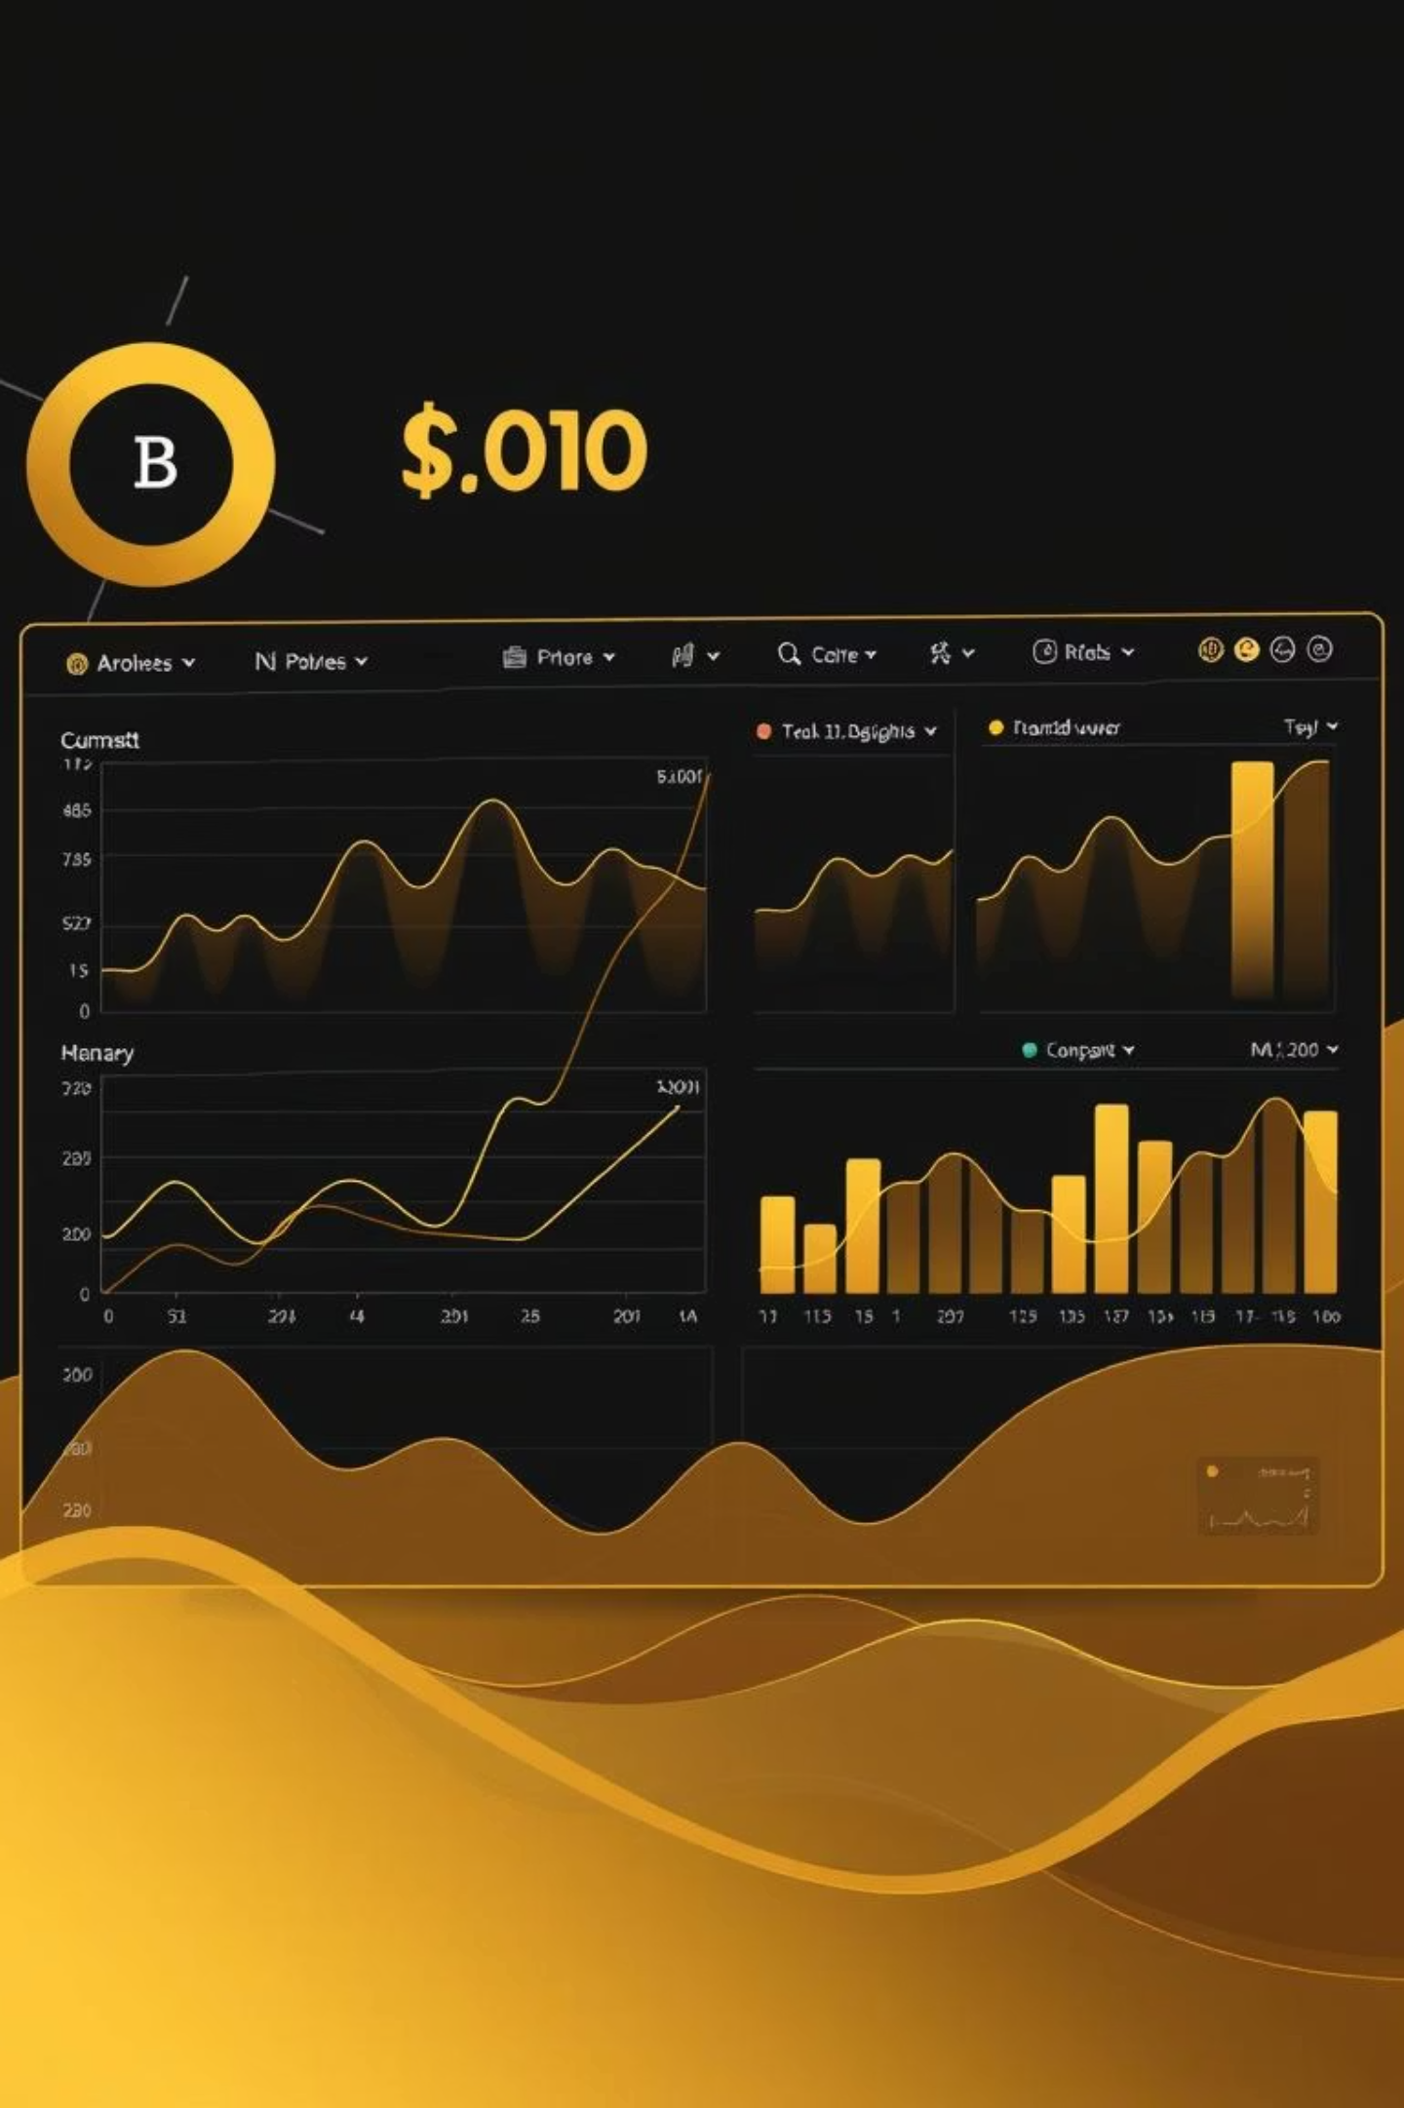





Insights from the Data: Market Dynamics
Our analysis reveals several crucial characteristics of the current job market landscape:
Market Scale
Experience Bias
The dataset contains 72,954 job records from 15,295 unique companies, averaging 4.8 jobs per company.
Most roles demand 3–10 years of experience, indicating a strong preference for mid-level professionals.
Leading Recruiters
Ubiquitous Skills
Companies like Lavya Associates (5,128 openings), Accenture, Hucon, Varite India Pvt. Ltd., and IBM consistently lead in job postings.
Sales, channel management, customer handling, and communication are universally sought-after skills.
HDFC Bank Specifics
For HDFC Bank, skills like "cross selling," "relationship management," and "portfolio management" are paramount.

Slide 7
Insights from the Data: Salary & Company Ratings
Diving deeper, our analysis uncovers patterns in compensation and organizational standing:
50%
6-9 LPA
Salary Disclosure Gap
Common Salary Band
Almost half of the job listings did not disclose salary information.
For moderate experience levels, the most frequent salary band is 6–9 Lakhs Per Annum.
A clear positive correlation exists between experience and salary:
0–1 Year Experience
10+ Years Experience
Avg. Min Salary: ₹2–2.8 lakhAvg. Max Salary: ₹3.5–4.1 lakh
Avg. Min Salary: Crosses ₹10 lakhAvg. Max Salary: Significant rise
Company ratings paint a picture of overall satisfaction:
The median company rating is 4.0 (ranging from 3.7 to 4.2).
Over 1,200 jobs are listed by companies with a perfect 5.0 rating.
Top-tier companies like TCS, RIL, and HDFC Bank consistently emerge as leaders when considering both ratings and review counts.

Slide 8
Conclusion: Key Takeaways & Challenges
The analysis of over 79,000 job listings has provided valuable insights, alongside highlighting common data challenges:
Data Transformation
Job Role Standardization
Initial 12 columns refined to a leaner, more useful dataset for analysis.
Significant variation in job titles (e.g., "Power BI", "BI Analyst") indicates a need for standardization.
Missing Values
Salary Transparency
Approx. 46% of rating/reviews were missing. "Experience" and "location" gaps were filled with popular options.
50% of salaries were "Not disclosed," with some erroneous entries (e.g., "MBA/PGDM"). Data cleaned for accuracy.
Massive Duplication
Industry Concentration
Over 5,000+ repeated rows were identified and removed for data integrity.
Job postings and reviews are heavily influenced by a few major players like TCS, Reliance, HDFC Bank, ICICI, and Accenture.

Slide 9





Future Scope: Enhancing Job Market Intelligence
Building on this foundational analysis, several avenues for future development promise even deeper insights and more powerful tools:
Advanced NLP for Role Standardization
Implement NLP and Large Language Models (LLMs) to automatically group similar job roles, reducing fragmentation and improving accuracy.
Predictive Market Trend Analytics
Develop machine learning models to forecast emerging job roles, skill demands, and salary trajectories, aiding proactive career planning.
Enhanced Compensation Analysis
Integrate comprehensive salary components (bonuses, variables) to provide realistic compensation insights and build robust salary prediction models.
Geographical & Remote Work Trends
Analyze location data to identify job growth hotspots and evolving remote/hybrid work patterns for targeted recruitment strategies.
Automated Resume & Skill Matching
Create automated systems to match candidate resumes with suitable job openings based on responsibilities and required skills, boosting recruitment efficiency.

Slide 10


